Slide 1
Parallel and Perpendicular Lines
Section 5-6

Slide 2
Vocabulary
Parallel lines
Perpendicular lines
Opposite reciprocals

Slide 3
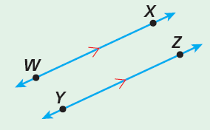
Definition
Parallel Lines - are lines in the same plane that never intersect.
Line WX is parallel to line YZ.
WX || YZ.

Slide 4
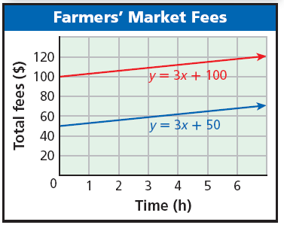
Parallel Lines
These two lines are parallel. Parallel lines are lines in the same plane that have no points in common. In other words, they do not intersect.
As seen on the graph, parallel lines have the same slope.
For y = 3x + 100, m = 3 and for y = 3x + 50, m = 3.

Slide 5
Parallel Lines

Slide 6
Example: Identifying Parallel Lines
Identify which lines are parallel.

Slide 7
Your Turn:
Identify which lines are parallel.
y = 2x + 2; y = 2x + 1; y = –4; x = 1

Slide 8
Your Turn:
Identify which lines are parallel.

Slide 9
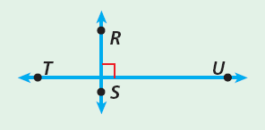
Definition
Perpendicular Lines – lines that intersect to form 90º angles, or right angles.
Line RS is perpendicular to line TU.
RS | TU.
__

Slide 10
Perpendicular Lines
Perpendicular lines have slopes that are opposite reciprocals.

Slide 11
Definition
Opposite Reciprocals – two numbers whose product is – 1.
Example:
To find the opposite reciprocal (also called negative reciprocal) of – 3/4, first find the reciprocal, –4/3.
Then write its opposite, 4/3.
Since -3/4 ∙ 4/3 = -1, therefore 4/3 is the opposite reciprocal of -3/4.

Slide 12
Opposite Reciprocals
Helpful Hint
If you know the slope of a line, the slope of a perpendicular line will be the "opposite reciprocal.”

Slide 13
Example: Indentifying Perpendicular Lines
Identify which lines are perpendicular: y = 3; x = –2; y = 3x; .

Slide 14
Your Turn:
Identify which lines are perpendicular: y = –4; y – 6 = 5(x + 4); x = 3; y =

Slide 15
Example: Writing Equations of Parallel and Perpendicular Lines
Write an equation in slope-intercept form for the line that passes through (4, 10) and is parallel to the line described by y = 3x + 8.

Slide 16
Example: Writing Equations of Parallel and Perpendicular Lines
Write an equation in slope-intercept form for the line that passes through (2, –1) and is perpendicular to the line described by y = 2x – 5.

Slide 17
Your Turn:
Write an equation in slope-intercept form for the line that passes through (5, 7) and is parallel to the line described by y = x – 6.

Slide 18
Your Turn:
Write an equation in slope-intercept form for the line that passes through (–5, 3) and is perpendicular to the line described by y = 5x.

